Slide 1

SE Asia
Factors of
ECONOMIC GROWTH
© Brain Wrinkles

Slide 2


OBJECTIVE
SS7E9 Describe factors that influence economic growth and examine their presence or absence in China, India, Japan, South Korea, and North Korea.
Evaluate how literacy rates affect the standard of living.
Explain the relationship between investment in human capital (education and training) and gross domestic product (GDP per capita).
Explain the relationship between investment in capital goods (factories, machinery, and technology) and gross domestic product (GDP per capita).
Describe the role of natural resources in a country’s economy.
Describe the role of entrepreneurship.
© Brain Wrinkles

Slide 3
Gross
Domestic
Product
© Brain Wrinkles

Slide 4
GDP
Economists measure the health of a country’s economy by its gross domestic product (GDP).
A country’s GDP is the total dollar value of all goods and services produced in one year.
Some countries have a high GDP, while others do not.
© Brain Wrinkles

Slide 5
per Capita
GDP is often measured as “GDP per capita” (per person).
Countries with a higher GDP per capita have stronger economies, while countries with lower GDP per capita have weaker economies.
GDP per capita is a good indicator of a country’s standard of living.
  The standard of living is the level of wealth and material comfort available to the people.
© Brain Wrinkles

Slide 6
SE Asia
For the most part, the GDP per capita in the Southern and Eastern Asian region tends to be lower than the figures found in Europe, Canada, Australia, and the United States.
However, the GDP per capita (for most countries) is higher than that of most African countries.
GDP per capita varies widely throughout the region.
© Brain Wrinkles

Slide 7
SE Asia
Country | GDP Per Capita
China | $10,261
India | $2,099
Japan | $40,246
South Korea | $31,846
North Korea | $1,300
United States | $65,297
© Brain Wrinkles

Slide 8
Productive
Resources
A nation’s productive resources determine the strength of its economy.
Productive resources are the materials and labor used to create goods and services.
The four main categories of productive resources are natural resources, human capital, capital goods, and entrepreneurship.
© Brain Wrinkles

Slide 9
Natural
Resources
© Brain Wrinkles

Slide 10
Natural
Resources
Natural resources are the materials that come from nature, such as land, forests, minerals, water, etc.
They play an important role in a country’s economy because they are fuel for industry and are a source of income when exported to other countries.
The availability of natural resources in a country greatly affects which industries develop there.
© Brain Wrinkles

Slide 11
SE Asia
SE Asian countries have certain natural resources in abundance and have used these resources to establish markets for key products.
For example, China has vast farmland for agricultural products like rice and soybeans.
India is rich in mineral resources like copper, coal, and iron ore.
Japan lacks many raw materials needed for industry but makes up for it with agricultural products like rice and fish.
© Brain Wrinkles

Slide 12
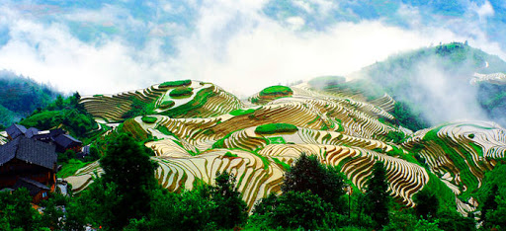
Rice Terraces in China
© Brain Wrinkles

Slide 13
SE Asia
China | India | Japan | S Korea | N Korea
Coal | Rice | Rice | Rice | Rice
Oil | Cotton | Fish | Barley | Corn
Natural gas | Copper |  | Wheat | Potatoes
Rice | Iron ore |  | Graphite | Zinc
Aluminum | Bauxite |  | Potatoes | Iron ore
Soybeans | Sugarcane |  | Soybeans | Coal
© Brain Wrinkles

Slide 14
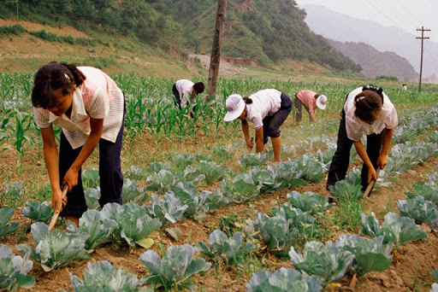
Cultivating Soybeans in South Korea
© Brain Wrinkles

Slide 15
Capital
Goods
© Brain Wrinkles

Slide 16
Capital Goods
Capital goods are the man-made materials that are needed to produce goods and services.
Some examples of capital goods include factories, machinery, technology, buildings, tools, etc.
The more a country invests in its capital goods, the stronger its economy and higher the GDP.
© Brain Wrinkles

Slide 17
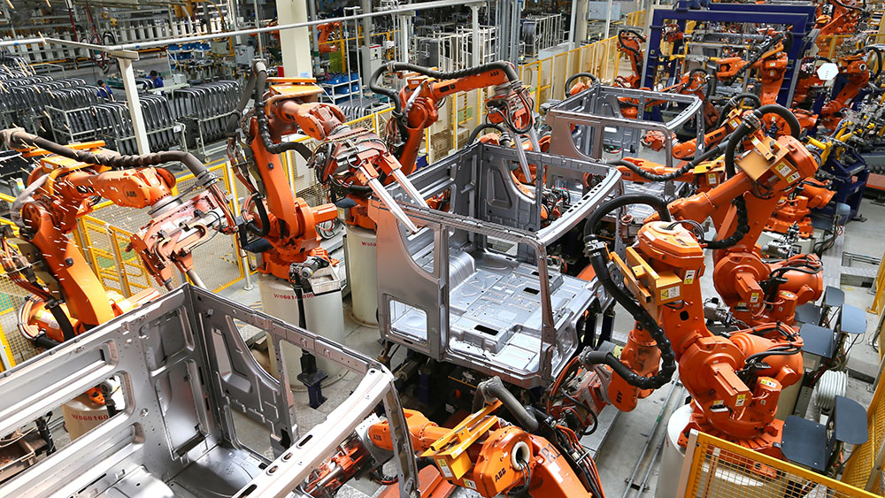
© Brain Wrinkles

Slide 18
Capital Goods
Investment in better machines, updated factories, and new technology leads to more goods and services being produced.
This boosts a country’s exports and its gross domestic product.
Investment in capital goods typically leads to an increase in GDP per capita.
© Brain Wrinkles

Slide 19
SE Asia
Governments of Japan, China, India, and South Korea have encouraged capital investments in order to strengthen their economies.
The countries have invested heavily in capital goods of new factories, machinery, and equipment, which has led to high levels of manufacturing and industry.
Their factories can produce a wide variety of valuable products, which has led to higher GDPs and stronger economies.
© Brain Wrinkles

Slide 20
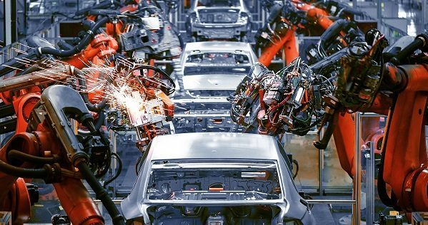
AI-Driven Factory in South Korea
© Brain Wrinkles

Slide 21
N Korea
North Korea, on the other hand, has only made small investments in capital goods over the past several decades.
Its outdated technology and inefficient factories have caused North Korea’s economy to suffer and fall behind on the world market.
© Brain Wrinkles

Slide 22
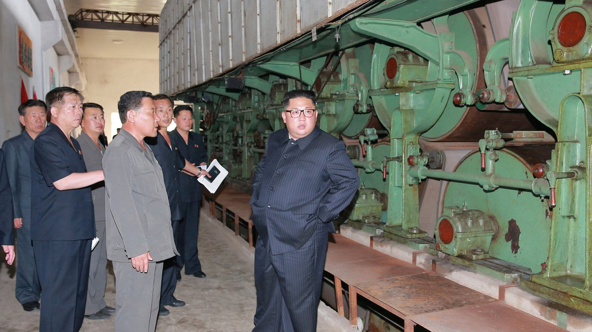
Supreme Leader Kim Jong Un oversees an industrial site in North Korea.
© Brain Wrinkles

Slide 23
Human
Capital
© Brain Wrinkles

Slide 24
Human Capital
Some of a country’s most important resources are its people.
Countries need skilled workers to fill jobs within the economy.
It takes different kinds of human capital to make different kinds of goods and services.
For example, doctors, teachers, and factory workers all have a different set of skills and they each help to produce different goods or services.
© Brain Wrinkles

Slide 25

© Brain Wrinkles

Slide 26
Human Capital
Investments in human capital, such as education and professional training programs, are a great way for a country to improve its GDP.
In order to have long-lasting economic growth, a country must have a smart, highly-skilled workforce.
Education also improves a country’s standard of living.
© Brain Wrinkles

Slide 27
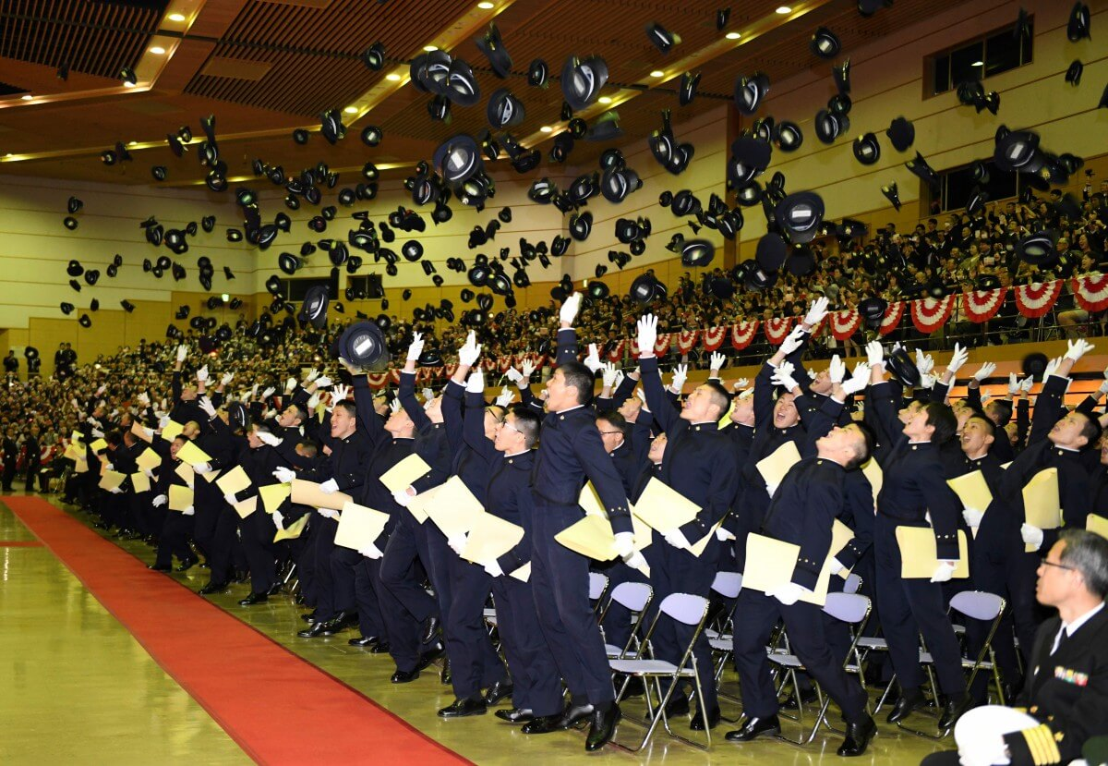
© Brain Wrinkles

Slide 28
SE Asia
Even though investments in education are lower, the governments of India, Japan, China, and South Korea invest aggressively in programs to train their people for specific jobs and industries.
These investments in job training have made their economies grow.
Their workers are trained, skilled, and can communicate well.
© Brain Wrinkles

Slide 29
SE Asia
SE Asian countries generally invest less of their budgets in K-12 education than other developed countries.
  The world average is 6% and Japan invests 3.2%
Enrollment numbers in secondary schools have fallen across the region.
In response, many SE Asian countries have ramped up their investment in colleges and universities to keep up economically.
© Brain Wrinkles

Slide 30
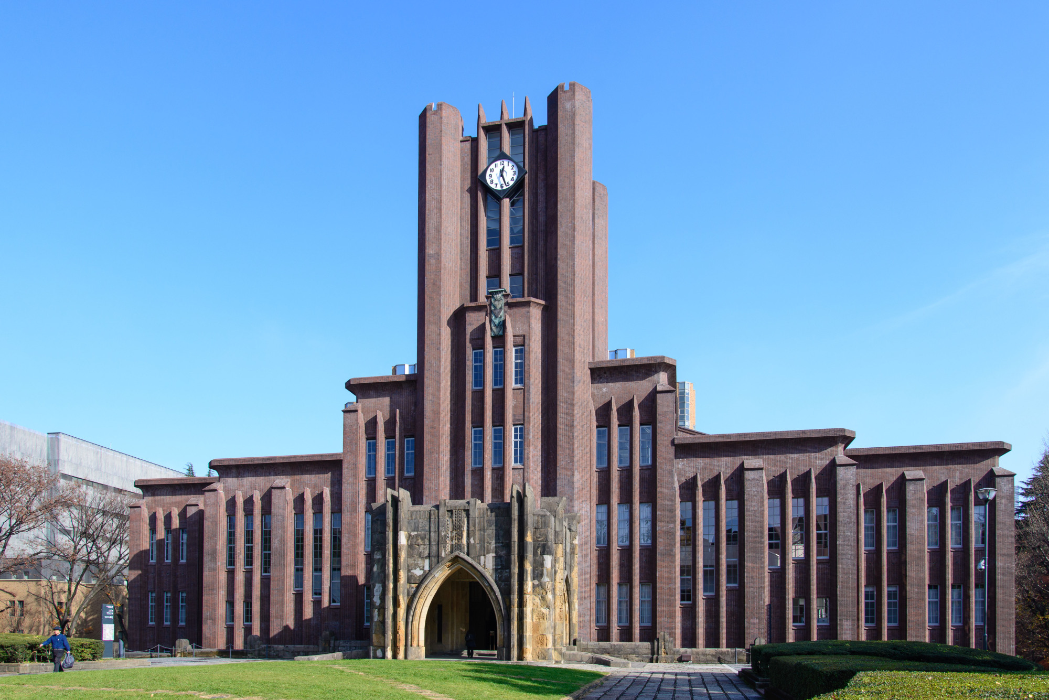
Tokyo University in Japan
© Brain Wrinkles

Slide 31
N Korea
North Korea invests heavily in human capital under the area of education.
Education in North Korea is universal and funded by the government.
  The self-reported national literacy rate for citizens 15 and older is (approximately) 100%.
Despite North Korea’s high education investment, the country’s economy still struggles to grow under the strict control of the Communist government.
© Brain Wrinkles

Slide 32
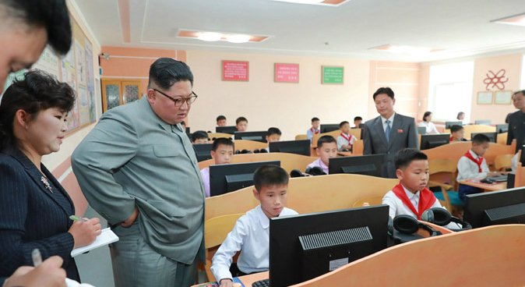
Leader Kim Jong Un overlooks middle school students in North Korea.
© Brain Wrinkles

Slide 33
Literacy
A country’s literacy rate is the percentage of adults who can read and write.
Countries with high literacy rates enjoy a high standard of living (the level of wealth and material comfort available).
Educated and skilled workers are an important factor in a country’s economic growth.
© Brain Wrinkles

Slide 34
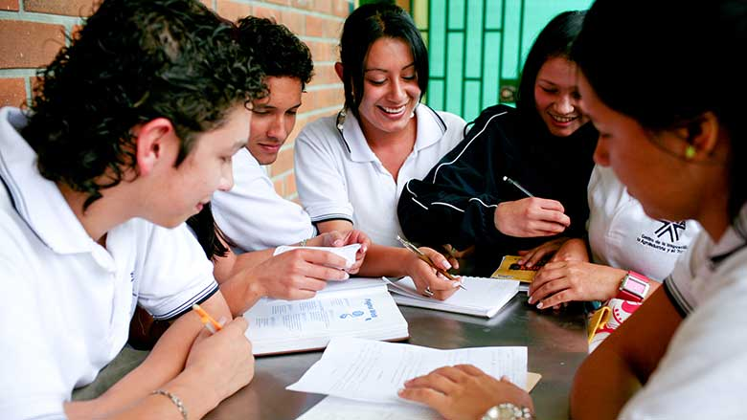
© Brain Wrinkles

Slide 35
Literacy
If you can read, you can learn and improve your work skills to get a better job that pays a higher salary.
  With a better salary, you can improve your standard of living.
A country that improves the literacy rate among its citizens will also improve the standard of living and economy.
© Brain Wrinkles

Slide 36
Literacy Rate
SE Asia’s literacy rates are generally higher than the worldwide average 86.3% (except for India).
Country | Literacy Rate
China | 96.4%
India | 72.1%
Japan | 99.%
South Korea | 98%
North Korea | 100%*
*self-reported
© Brain Wrinkles

Slide 37
TEACHER info
Print off the GDP per Capita, Natural Resources, Capital Goods, Human Capital & Literacy Rate, and Entrepreneurship sheets for each student. (Print front-to-back to save paper.)
The students will complete each sheet after the corresponding section of the lesson.
Check and correct the answers as a class. (Answer keys on slides 71-75.)
© Brain Wrinkles

Slide 38
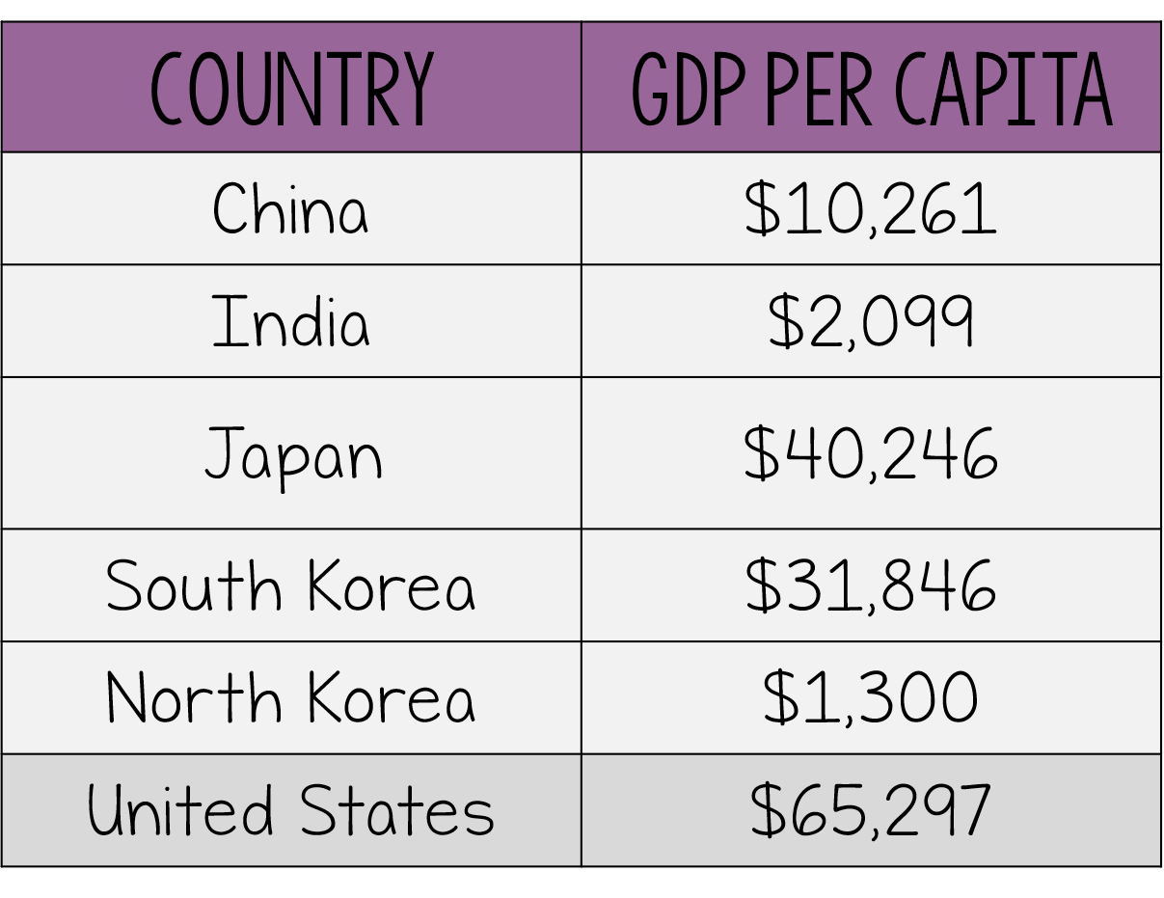

Evaluate
GDP per Capita
Use the chart to answer the questions.
Define GDP:
Define GDP per Capita:
How does a country’s GDP per capita impact its standard of living?
Which SE Asian country has the lowest GDP per capita? Who makes the economic decisions in this country?
Which SE Asian country has the highest GDP per capita? What can you infer about this country’s standard of living when compared to the standard of living in the United States? What does this say about the standard of living of SE Asia as a whole region?
© Brain Wrinkles

Slide 39
Evaluate
Natural Resources
Define natural resources:
What role do natural resources play in a country’s economy? (Why do countries need natural resources?)
List at least two important natural resources for each country.
Japan is an island country with limited natural resources. What must Japan do in order to get the resources that its citizens need?
China | India | Japan | S Korea | N Korea
© Brain Wrinkles

Slide 40
Evaluate
Capital Goods
When a country invests in new machinery, technology, and factories, it is increasing its:
Write a statement that describes the relationship between a country’s investment in capital goods and its GDP:
How have Japan, China, India, and South Korea invested in capital goods? How has this level of investment impacted their economies?
Describe North Korea’s investment in capital goods. How has this level of investment impacted North Korea’s economy?
© Brain Wrinkles

Slide 41

Evaluate
Human Capital &
Literacy Rate
Use the chart to answer the questions.
Japan invests 3.2% of its GDP into education for its citizens—which productive resource is this an example of?
South Korea’s literacy rate is 98%. What does this mean?
Explain how the literacy rate ties into a country’s standard of living:
Based on what you know about literacy rates, which country probably has the highest standard of living—India or Japan? Explain.
Do you think the SE Asian governments investments in human capital (education, job training, etc.) are having a positive impact on their economies? Explain.
North Korea has a literacy rate of approximately 100%. Why have these education investments not produced results in North Korea’s economy as easily as in Japan and South Korea’s?
Literacy Rates | Literacy Rate
China | 96.4%
India | 72.1%
Japan | 99.%
South Korea | 98%
North Korea | 100%
World Average | 86%
© Brain Wrinkles

Slide 42
Evaluate
Entrepreneurship
Define entrepreneur:
What role does entrepreneurship play in a country’s economy? (Why do countries need entrepreneurs?)
Overall, starting a new business in China and India is (easier/harder) than the world average.
If you were going to start a business in SE Asia, in which country would you choose to start your business in? Explain.
Why do you think that North Korea’s overall business freedom (5%) is so low? (Think about what you know about North Korea’s government.)
© Brain Wrinkles

Slide 43
Evaluate
GDP per Capita
Use the chart to answer the questions.
Define GDP:
amount of goods and services produced within a country in a year
Define GDP per Capita:
the annual income of a country’s people
How does a country’s GDP per capita impact its standard of living?
The higher the GDP per capita, the higher the standard of living (and vice versa)
Which SE Asian country has the lowest GDP per capita? Who makes the economic decisions in this country?
North Korea; the government
Which SE Asian country has the highest GDP per capita? What can you infer about this country’s standard of living when compared to the standard of living in the United States? What does this say about the standard of living of SE Asia as a whole region? Japan; even though the GDP per capita is higher than the other countries in SE Asia, it is still lower than the US’. The standard of living is higher in the US than in Japan (and the rest of SE Asia).
© Brain Wrinkles

Slide 44
Evaluate
Natural Resources
Define natural resources:
Materials found in nature (“gifts of nature)
What role do natural resources play in a country’s economy? (Why do countries need natural resources?)
Natural Resources are a source of income when exported.
List at least two important natural resources for each country.
Japan is an island country with limited natural resources. What must Japan do in order to get the resources that its citizens need?
Import resources from other countries (costs $$)
China | India | Japan | S Korea | N Korea
Coal Oil natural gas | Rice Cotton copper | Fish rice | Rice Barley graphite | Rice Zinc iron ore
© Brain Wrinkles

Slide 45
Evaluate
Capital Goods
When a country invests in new machinery, technology, and factories, it is increasing its:
Capital goods
Write a statement that describes the relationship between a country’s investment in capital goods and its GDP:
Answers will vary; When a country invests heavily in capital goods, it generally leads to the country having a high GDP
How have Japan, China, India, and South Korea invested in capital goods? How has this level of investment impacted their economies?
These countries have invested heavily in capital goods of machinery and equipment, which has led to high levels of manufacturing and industry. Their factories can produce a wide variety of valuable products, which has led to higher GDPs and stronger economies.
Describe North Korea’s investment in capital goods. How has this level of investment impacted North Korea economy?
North Korea has under-invested in capital goods for many years. It has outdated technology and inefficient factories. North Korea’s economy suffers and can’t produce goods to keep up with the world market.
© Brain Wrinkles

Slide 46
Evaluate
Human Capital &
Literacy Rate
Use the chart to answer the questions.
Japan invests 3.2% of its GDP into education for its citizens—which productive resource is this an example of?
Human capital
South Korea’s literacy rate is 98%. What does this mean?
98% of adults in South Korea can read and write
Explain how the literacy rate ties into a country’s standard of living:
If you can read/write, you can get a good job. Generally speaking, the better educated you are, the better salary you can receive. With a higher salary, you can improve your standard of living.
Based on what you know about literacy rates, which country probably has the highest standard of living—India or Japan? Explain.
Answers will vary, but Japan has a 99% literacy rate; gov invests money into education, people who are educated have a better chance of getting better paying jobs and can afford a better quality of life
Do you think the SE Asian governments investments in human capital (education, job training, etc.) are having a positive impact on their economies? Explain.
Answers will vary; but yes, high literacy rate generally equals a high standard of living; education improves a country’s standard of living
North Korea has a literacy rate of approximately 100%. Why have these education investments not produced results in North Korea’s economy as easily as in Japan and South Korea’s?
North Korea’s economy struggles to grow under the strict control of the leader & Communist government
Literacy Rates | Literacy Rate
China | 96.4%
India | 72.1%
Japan | 99.%
South Korea | 98%
North Korea | 100%
World Average | 86%
© Brain Wrinkles

Slide 47
Evaluate
Entrepreneurship
Define entrepreneur:
someone who takes risks to start a new business
What role does entrepreneurship play in a country’s economy? (Why do countries need entrepreneurs?)
They help the economy grow by opening new businesses and developing new products, which creates more jobs.
Overall, starting a new business in China and India is (easier/harder) than the world average.
Harder
If you were going to start a business in SE Asia, in which country would you choose to start your business in? Explain.
Answers will vary, but most will say South Korea because the overall business freedom is much higher and it only takes 4 days to get a business started.
Why do you think that North Korea’s overall business freedom (5%) is so low? (Think about what you know about North Korea’s government.)
North Korea’s Communist central government makes all economic decisions. It is against the law to start a business in North Korea. The government is involved in the process (rules & regulations) of every business.
© Brain Wrinkles

Slide 48
TEACHER info
Print off the Factors of Production graphic organizer for each student. (Print front-to-back to save paper.)
The students will complete the chart with information from the presentation.
Check and correct the answers as a class. (Answer keys on slides 79-80.)
© Brain Wrinkles

Slide 49
Organize
Factors of Production
 | China | Japan | South Korea
Natural Resources
Human Capital & Literacy Rate
Capital Goods
Entrepreneurship
© Brain Wrinkles

Slide 50
Organize
Factors of Production
 | India | North Korea
Natural Resources
Human Capital & Literacy Rate
Capital Goods
Entrepreneurship
© Brain Wrinkles

Slide 51
Organize
Factors of Production
 | China | Japan | South Korea
Natural Resources | Coal, oil, natural gas, rice, aluminum, soybeans | Rice, fish | Rice, barley, wheat, graphite, potatoes, soybeans
Human Capital & Literacy Rate | Does not invest as much of GDP in education as world average Secondary education rates are dropping Spends much of budget on job training programs 96.4% literacy rate | Does not invest as much of GDP in education as world average Secondary education rates are dropping Spends much of budget on job training programs 99% literacy rate | Does not invest as much of GDP in education as world average Secondary education rates are dropping Spends much of budget on job training programs 98% literacy rate
Capital Goods | Invests in machinery and equipment, which leads to high levels of manufacturing and industry | Invests in machinery and equipment, which leads to high levels of manufacturing and industry | Invests in machinery and equipment, which leads to high levels of manufacturing and industry
Entrepreneurship | 56% Overall Business Freedom; 29 Days to Start Heavy government regulations, cultural biases, and high taxes make starting a business a slow process | 82% Overall Business Freedom; 11 Days to Start Entrepreneurship is growing | 91% Overall Business Freedom; 4 Days to Start A lot of freedom for business owners
© Brain Wrinkles

Slide 52
Organize
Factors of Production
 | India | North Korea
Natural Resources | Rice, cotton, copper, iron ore, bauxite, sugarcane | rice, corn, potatoes, iron ore, coal, zinc
Human Capital & Literacy Rate | Does not invest as much of GDP in education as world average Secondary education rates are dropping Spends much of budget on job training programs 72% literacy rate | Strong investment in universal state-funded education Self-reported 100% literacy rate
Capital Goods | Invests in machinery and equipment, which leads to high levels of manufacturing and industry | Only makes small investments in capital goods; outdated technology and inefficient factories have caused North Korea to fall behind on world market
Entrepreneurship | 53% Overall Business Freedom; 26 Days to Start -heavy government regulations, cultural biases, and high taxes make starting a business a slow process | 5% Overall Business Freedom; entrepreneurship is not allowed because gov. controls everything Economy struggles to grow under control of Communist government
© Brain Wrinkles

Slide 53
TEACHER info
Print off the GDP Shopping Spree for each student.
The students will imagine that they are a country who is “shopping” for productive resources in order to boost economic strength.
The students will write statements about which resources they would choose to “buy” and then explain their answers. *The students should challenge themselves to write at least three things for each section.
Example: Natural Resources – Hydroelectricity because alternative energy sources are in high demand and could be exported to boost the economy.
© Brain Wrinkles

Slide 54



GDP Shopping Spree
Directions: Imagine that you are a country who is “shopping” for productive resources in order to boost your economic strength. Write statements about which resources you would choose to “buy” and explain your answer. Challenge yourself to write at least three things for each section.
Natural Resources | Capital Goods
Human Capital | Entrepreneurship
© Brain Wrinkles

Slide 55
TEACHER info
Print off the Ticket Out the Door for each student.
The students will choose one of the countries from this lesson to receive an award based on its factors of production/economic strength (or lack thereof…).
They will design a “Most Likely to…” award for the country that will be featured in the Global Economic Yearbook. Students should think about what they have learned about the country’s economy, specifically its natural resources, human capital and capital investments, and entrepreneurs.
In the textbox, students will explain why the country was chosen for this award. They will draw an image/symbol that relates to the topic in the light gray area.
© Brain Wrinkles

Slide 56


TICKET Out THE DOOR
Directions: Choose one of the countries from this lesson to receive an award based on its factors of production/economic strength. Design a “Most Likely to…” award for the country that will be featured in the Global Economic Yearbook. Think about what you have learned about the country’s economy, specifically its natural resources, human capital and capital investments, and entrepreneurs. Include an image that represents the topic explain why the country was chosen for this award in the textbox.
Goes To:
For:
Most Likely To:
© Brain Wrinkles

Slide 57
TEACHER info
Print off the Comprehension Check for each student.
This is a quiz for the students to complete at the end of this lesson.
The answer key is on slide 87.
© Brain Wrinkles

Slide 58

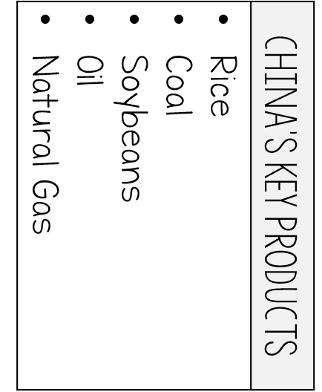

5. What factor of economic growth is represented? Natural Resources Human Capital Capital Goods Entrepreneurship | 4. Investing in human capital means spending money on: excavating natural resources updating factories and machinery developing new business ideas providing education and job training opportunities | 3. Japan's GDP per Capita is about $39,000 while India's is about $6,000. Which country more than likely has a higher standard of living? Japan India Neither | 2. What factor of production is represented by the chart? Human Capital Natural Resources Capital Goods Entrepreneurship | 1. Match gross domestic product (GDP) with the situation in Southern and Eastern Asia: Japan and South Korea have a high GDP per capita and a high standard of living. Japan and South Korea have a high GDP per capita and a low standard of living. Japan and South Korea have a low GDP per capita and a high standard of living. Japan and South Korea have a low GDP per capita and a low standard of living.
10. What would MOST LIKELY be the reason that North Korea's literacy rate does not match its standard of living? North Korea does not invest in education, which results in a high standard of living. North Korea has a Communist government that makes all the economic decisions. North Korea invests heavily in education, which results in a low standard of living. North Korea has a high number of entrepreneurs with poorly run businesses. | 9. What country's capital goods are represented in the chart? Japan South Korea North Korea China | 8. Trying to launch a business in India and China can be difficult because of: Strict government regulations Cultural biases High taxes All of the above | 7. An entrepreneur organizes ______ for production. Raw materials Skills and knowledge Factories and machinery New ideas | 6. What is one way that North Korea has invested in developing its human capital? Improving access to electricity for farmers. Updating factory equipment and machinery. Providing universal and state-funded education for students. Expanding highways and railroads.
© Brain Wrinkles
Circle the correct answers.
Comprehension Check

Slide 59
5. What factor of economic growth is represented? Natural Resources Human Capital Capital Goods Entrepreneurship | 4. Investing in human capital means spending money on: excavating natural resources updating factories and machinery developing new business ideas providing education and job training opportunities | 3. Japan's GDP per Capita is about $39,000 while India's is about $6,000. Which country more than likely has a higher standard of living? Japan India Neither | 2. What factor of production is represented by the chart? Human Capital Natural Resources Capital Goods Entrepreneurship | 1. Match gross domestic product (GDP) with the situation in Southern and Eastern Asia: Japan and South Korea have a high GDP per capita and a high standard of living. Japan and South Korea have a high GDP per capita and a low standard of living. Japan and South Korea have a low GDP per capita and a high standard of living. Japan and South Korea have a low GDP per capita and a low standard of living.
10. What would MOST LIKELY be the reason that North Korea's literacy rate does not match its standard of living? North Korea does not invest in education, which results in a high standard of living. North Korea has a Communist government that makes all the economic decisions. North Korea invests heavily in education, which results in a low standard of living. North Korea has a high number of entrepreneurs with poorly run businesses. | 9. What country's capital goods are represented in the chart? Japan South Korea North Korea China | 8. Trying to launch a business in India and China can be difficult because of: Strict government regulations Cultural biases High taxes All of the above | 7. An entrepreneur organizes ______ for production. Raw materials Skills and knowledge Factories and machinery New ideas | 6. What is one way that North Korea has invested in developing its human capital? Improving access to electricity for farmers. Updating factory equipment and machinery. Providing universal and state-funded education for students. Expanding highways and railroads.
© Brain Wrinkles
Circle the correct answers.
Comprehension Check

